Slide 1
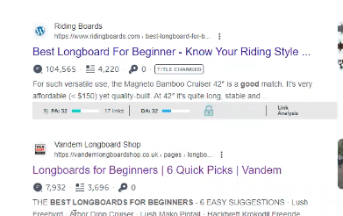
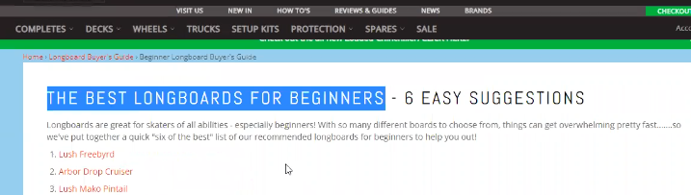
Make sure korte hobe 6ta jaigai jani keyword thake.
1.url e thakte hobe.
2.Title e thakte hobe .
3.Description e .
4.Page r h1 e thakte hobe .
5.Feature image r alt tag e ase kina .inspect > photo hover
Allintitle:
Keyword prominence: Jodi keyword venge venge thake tobe promince No hobe
Moz extention
Ubbersuggest extention

